Slide 1

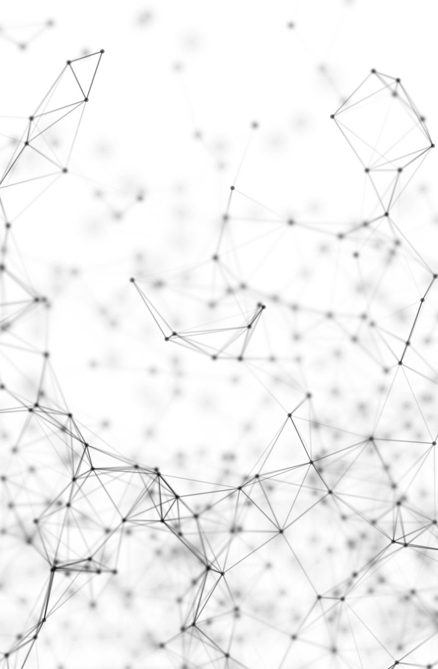
Reinforcement Learning
Zain Hasan
W10D3 – Part
Adapted from Arunabh’s Slides

Slide 2
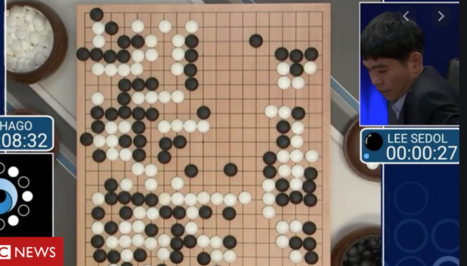
Reinforcement Learning
Reinforcement learning (RL) is an area of machine learning that focuses on how you, or how some thing, might act in an environment in order to maximize some given reward.
Reinforcement learning algorithms study the behavior of subjects in such environments and learn to optimize that behavior.
A commonly referred to domain that can illustrate the power of reinforcement learning is in game playing.

Slide 3
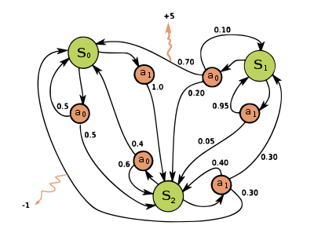
Markov Decision Processes source: deep lizard
In an MDP, we have a decision maker, called an agent, that interacts with the environment it's placed in.
These interactions occur sequentially over time.
At each time step, the agent will get some representation of the environment’s state.
Given this representation, the agent selects an action to take. The environment is then transitioned into a new state, and the agent is given a reward as a consequence of the previous action.
Components of an MDP:
Agent
Environment
State
Action
Reward

Slide 4
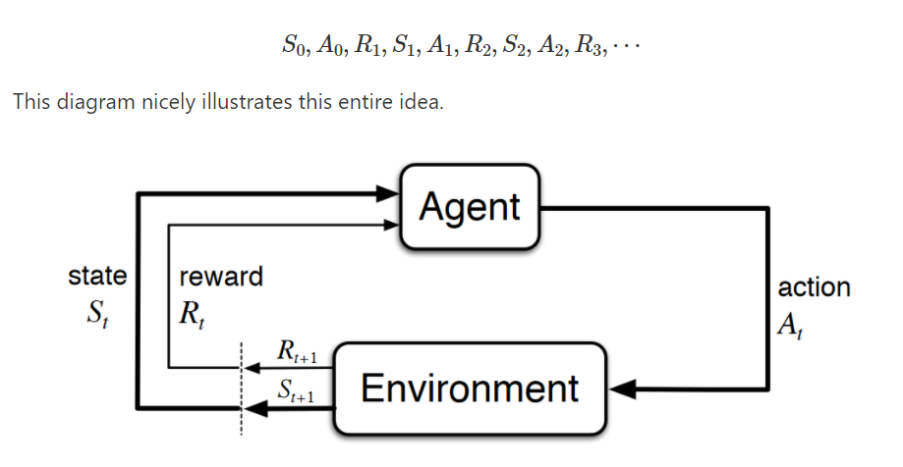
Markov Decision Processes source: deep lizard
This process of selecting an action from a given state, transitioning to a new state, and receiving a reward happens sequentially over and over again, which creates something called a trajectory that shows the sequence of states, actions, and rewards.
Throughout this process, it is the agent’s goal to maximize the total amount of rewards that it receives from taking actions in given states.
This means that the agent wants to maximize not just the immediate reward, but the cumulative rewards it receives over time.

Slide 5
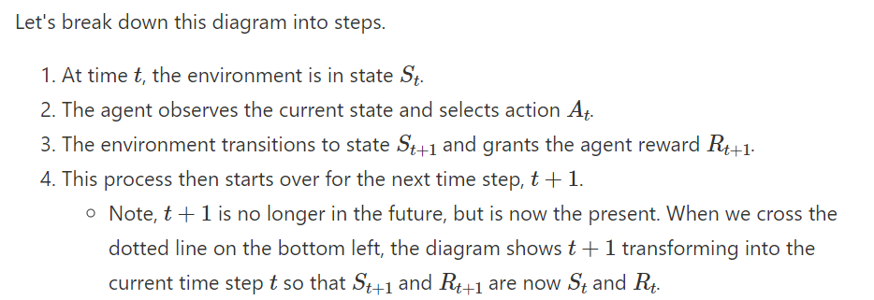
Markov Decision Processes source: deep lizard

Slide 6
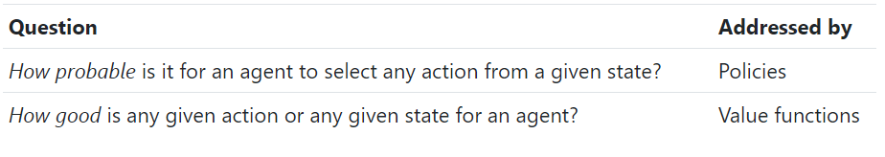
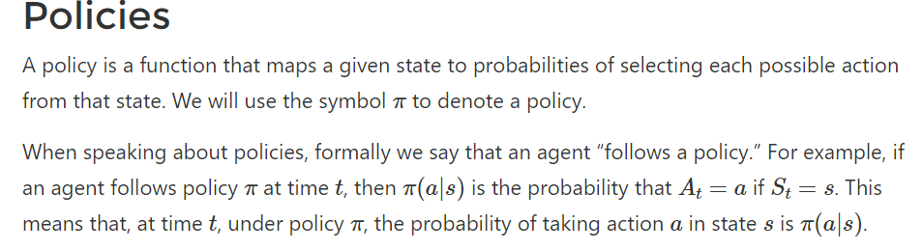
Markov Decision Processes source: deep lizard
Policies And Value Functions
For each state s E S, P or pie symbol is a probability distribution over a E A.
Notes:
We can say, analogously, that intelligence is the capacity of the agent to select the appropriate strategy in relation to its goals. Strategy, a teleologically-oriented subset of all possible behaviors, is here connected to the idea of “policy”.
A policy is, therefore, a strategy that an agent uses in pursuit of goals. The policy dictates the actions that the agent takes as a function of the agent’s state and the environment.

Slide 7
Values/Utility Functions and Policies
Policies
What’s the probability that an agent will select a specific action from a specific state?
Value/Utility
How good is a specific action or a specific state for the agent.

Slide 8
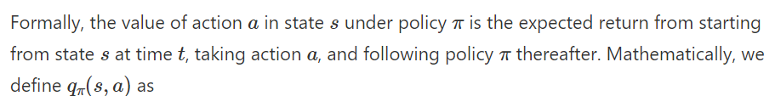
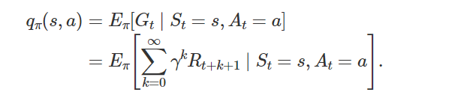
Markov Decision Processes source: deep lizard
Policies And Value Functions

Slide 9
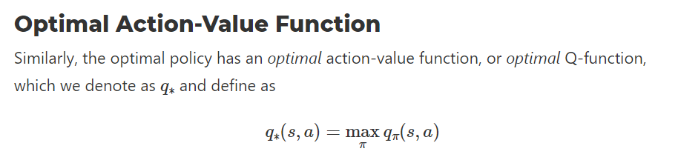
Q learning
It is the goal of reinforcement learning algorithms is to find the policy that maximizes the expected sum of rewards. – called the optimal policy

Slide 10
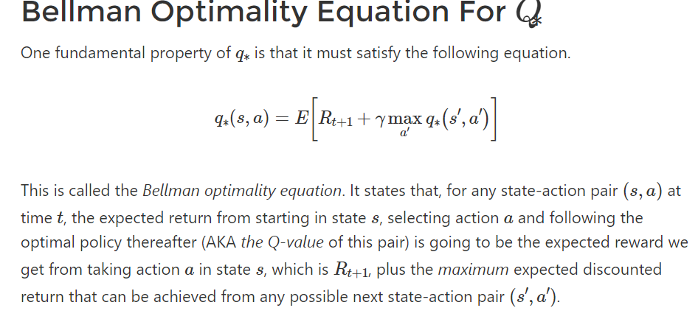
Bellman Equation

Slide 11
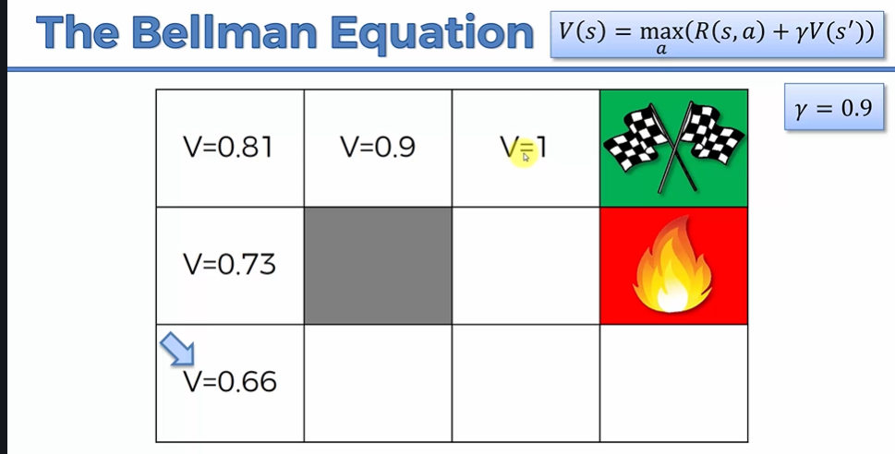
Bellman Equation Intuition

Slide 12
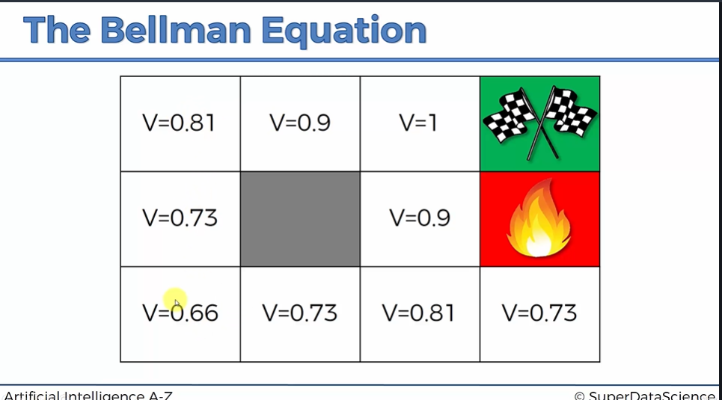
Bellman Intuition

Slide 13
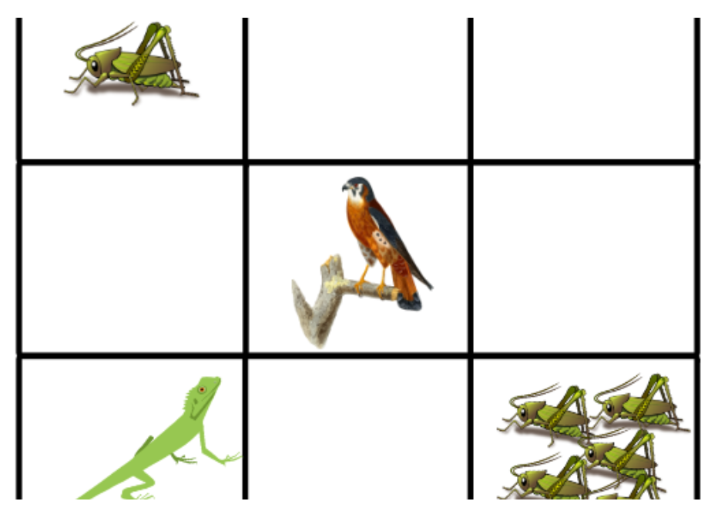
Q Learning Process
To left is the environment we are using.
Lizard is an agent
If it eats cricket it gets a reward
If it goes near the bird, it gets eaten up
Rewards are positive and negative.
Lets look at our reward/Q-table in the next slide.

Slide 14
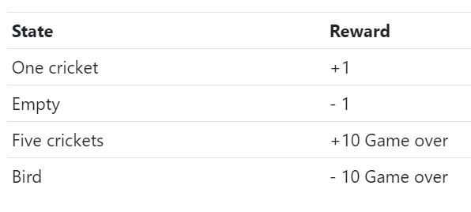
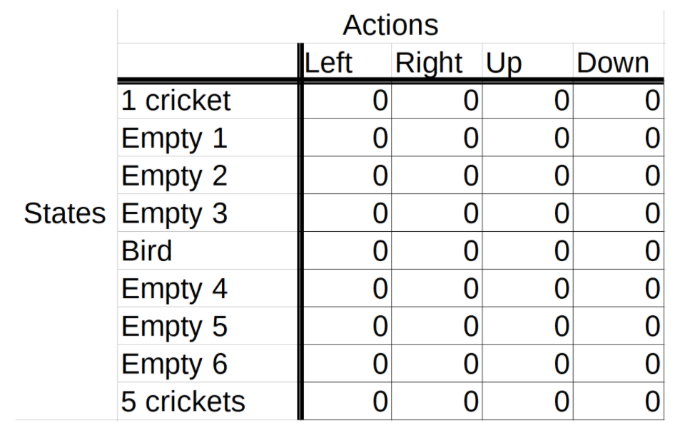
Rewards and initial Q-Table
Initial rewards are defined.
A q table is maintained and updated as agent interacts again and again with an environment over time.
It gets updated over time.
In each episode, the lizard starts out by choosing an action from the starting state based on the current Q-values in the table.
The lizard chooses the action based on which action has the highest Q-value in the Q-table for the current state.

Slide 15
Exploration and Exploitation
The goal of an agent is to maximize the expected return, so you might think that we want our agent to use exploitation all the time and not worry about doing any exploration. This strategy, however, isn’t quite right.
Think of our game. If our lizard got to the single cricket before it got to the group of five crickets, then only making use of exploitation, going forward the lizard would just learn to exploit the information it knows about the location of the single cricket to get single incremental points infinitely. It would then also be losing single points infinitely just to back out of the tile before it can come back in to get the cricket again.
This is implemented by specifying a probability(epsilon) that the agent takes a random action at any point in time for the sake of exploring its possibilities. – Point on epsilon decay

Slide 16
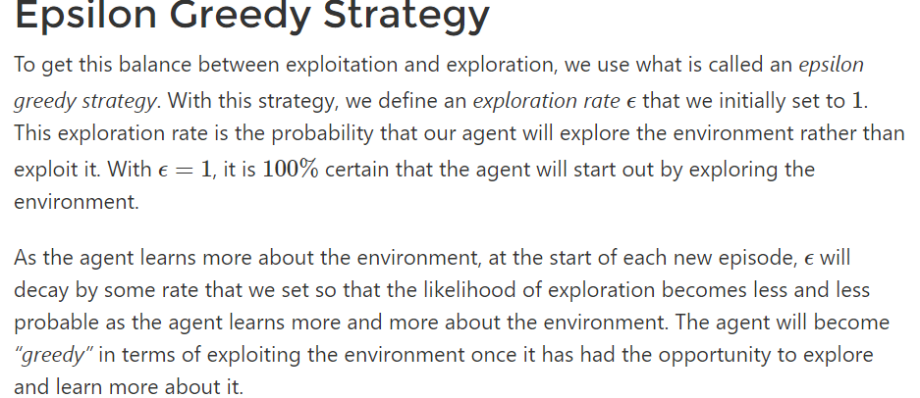
Epsilon Greedy Strategy source: deep lizard

Slide 17
Reinforcement Learning Online Demo
http://projects.rajivshah.com/rldemo/
https://cs.stanford.edu/people/karpathy/convnetjs/demo/rldemo.html
https://gym.openai.com/envs/#classic_control

Slide 18
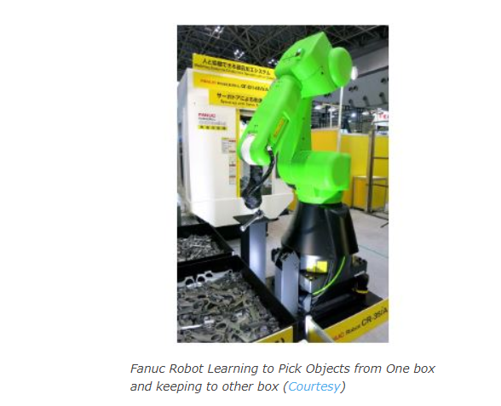
Reinforcement Learning Use Cases
Fanuc, the Japanese company, has been leading with its innovation in the field of industry-based robots.
For the past few years, Fanuc has been working actively to incorporate deep reinforcement learning in their own robots.
This Japanese Giant uses deep reinforcement learning for their robots in such a way that the robots train on their own for the most basic task of picking an object from one box and placing it into another box.
This process of training is repeated for different kinds of tasks and thus build such robots that can complete complex tasks as well.

Slide 19
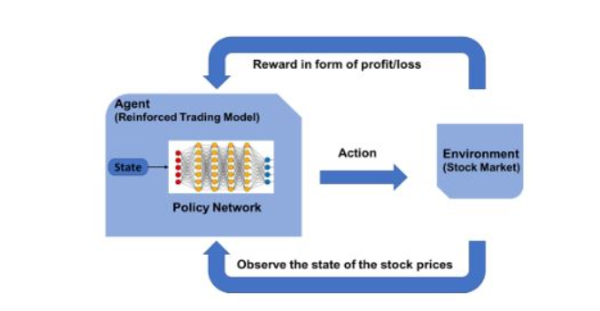
Use case 2- Trading
Pit.ai has been a pioneer in implementing stock trading through reinforcement learning.
Company’s founder Yves-Laurent Kom Samo looks to change the way reinforcement learning is used for such types of tasks, according to him.

Slide 20
Use case -3 Reduction in Energy Consumption
Tech Giant Google has leveraged reinforcement learning in the most unique way. Google has numerous data centers that can heat up extremely high. To mitigate this problem, Google uses AlphaGo built by DeepMind, for figuring out the optimal method that can help in designing the cooling infrastructure.
The aim was to reduce the energy consumed by fans and ventilation. AlphaGo is providing recommendations on how efficiently energy should be put to use in the cooling of data centers. The results were quite good as the energy requirement was reduced to 40%, thus resulting in a huge reduction in costs.

Slide 21
Topic Questions or Revisions – Back to Jupyter

